Slide 1
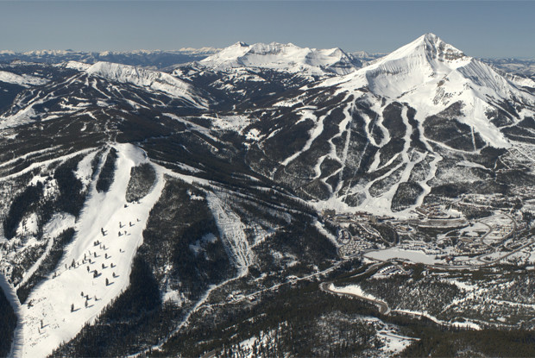
Big Mountain Resort Project

Slide 2
Agenda
Problem Identification
Recommendation
Modeling results and Analysis
Summary and conclusion

Slide 3
Problem Statement
How to select a better pricing strategy during this season to capitalize on the current equipment and amenities, increasing the ticket price based on other resorts’ amenities ?
H
1
Context
Big Mountain Resort, a ski resort located in Montana, offers spectacular views of Glacier National Park and Flathead National Forest, with access to 105 trails. Every year about 350,000 people ski or snowboard at Big Mountain. The Resort has recently installed an additional chair lift to help increase the distribution of visitors across the mountain. This additional chair increases their operating costs by $1,540,000 this season.
2
Criteria for success
Have a better pricing strategy during the season that capitalize on the equipment and resorts’ amenities.
3
Scope of solution space
Pricing strategy on the ticket price, operating costs of the resort and resorts amenities.
H
D
E
I
P

Slide 4
Problem Statement
How to select a better pricing strategy during this season to capitalize on the current equipment and the new lift addition of $1,540,000, increasing the ticket price based on other resorts ?
H
4
Constraints within solution space
The resort has 11 lifts, 2 T-bars, and 1 magic carpet for novice skiers. The longest run is named Hellfire and is 3.3 miles in length. The base elevation is 4,464 ft, and the summit is 6,817 ft with a vertical drop of 2,353 ft. Access to the resort with 105 trails
Every year about 350,000 people ski or snowboard at Big Mountain
Limitations to the premium above average approach
5
Stakeholders to provide key insight
Director of Operations, Jimmy Blackburn
Alesha Eisen, the Database Manager
Data Science Team
6
Key data sources
Single CSV file provided by the database manager
Data snippet
The column descriptions in the metadata
H
D
E
I
P

Slide 5
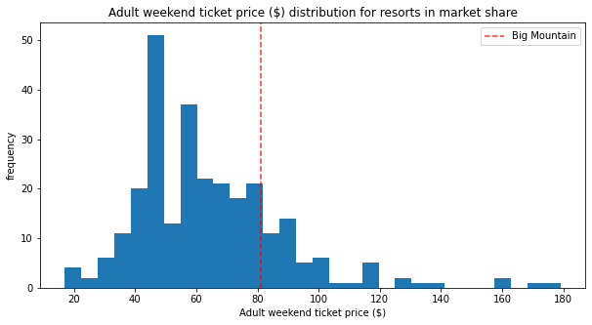
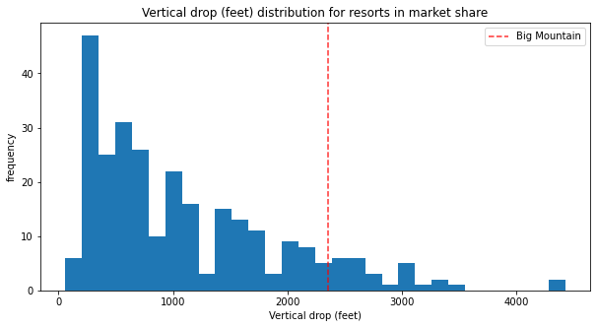
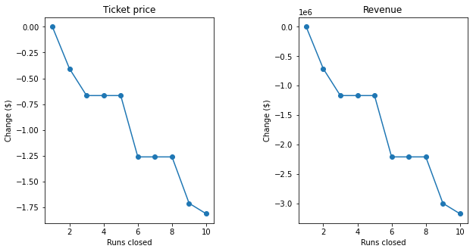
Recommendation
A
Big Mountain Resort ticket price could be $95.87
B
Increase the vertical drop by 150 feet
C
Close 5 runs

Slide 6
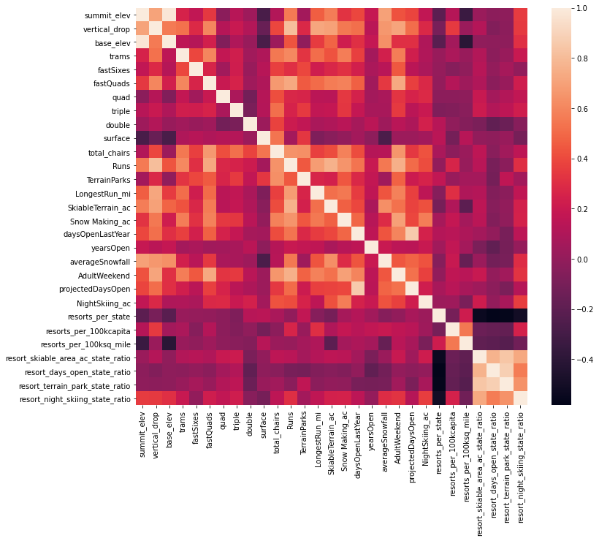
Modeling results & Analysis
Key features identified by the model
vertical_drop
Snow Making_ac
total_chairs
fastQuads
Runs
LongestRun_mi
trams
SkiableTerrain_ac

Slide 7
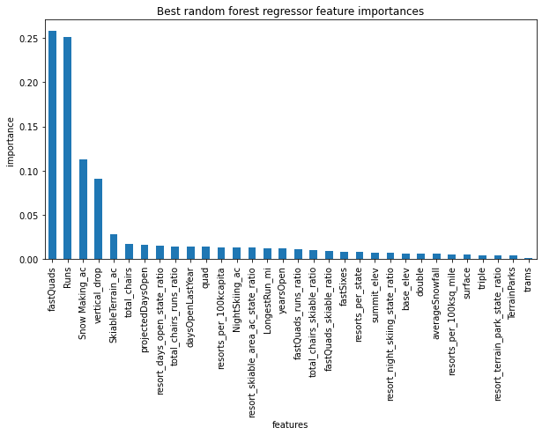
Modeling results & Analysis
Best random forest regressor feature importance
fastQuads
Runs
Snow Making_ac
vertical_drop

Slide 8
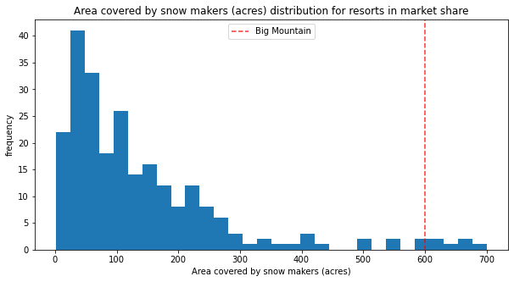
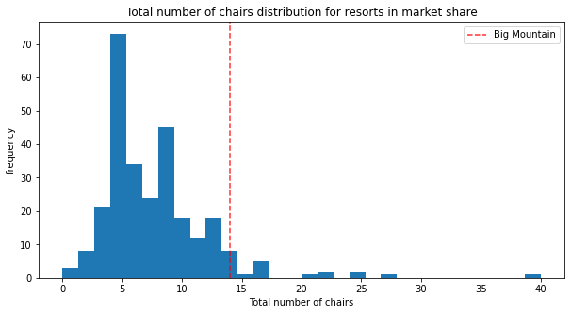
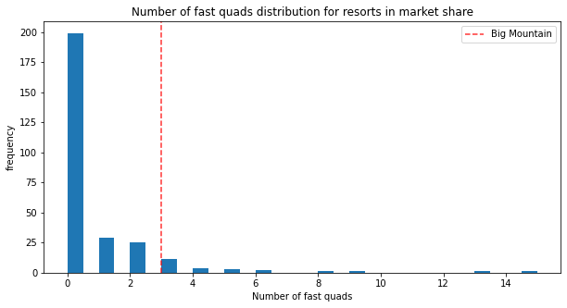
Modeling results & Analysis
Big Mountain is doing well for vertical drop
Big Mountain is very high up the league table of snow making area.
Big Mountain has amongst the highest number of total chairs, resorts with more appear to be outliers.
Most resorts have no fast quads. Big Mountain has 3, which puts it high up that league table.

Slide 9
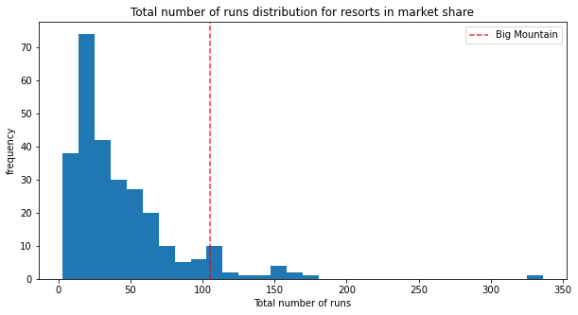
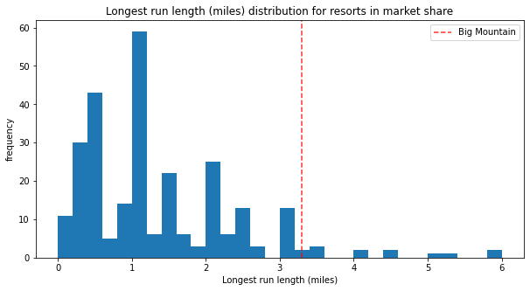
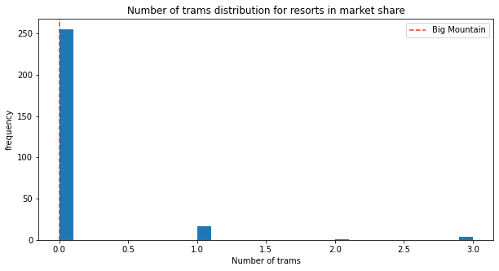
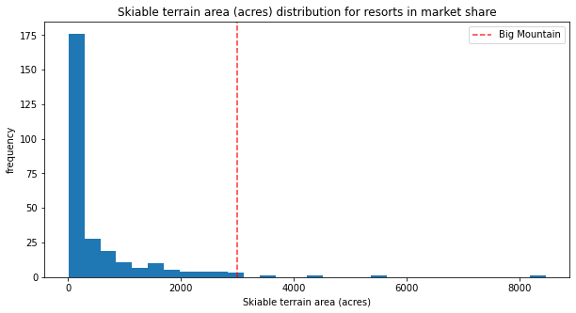
Modeling results & Analysis
Big Mountain compares well for the number of runs.
Big Mountain has one of the longest runs. The longer ones are rare.
Most resorts, such as Big Mountain, have no trams.
Big Mountain is amongst the resorts with the largest amount of skiable terrain.

Slide 10
Summary & Conclusion
Big Mountain Resort modelled price is 95.97, actual price is 81.00.
The pricing ticket strategy support the increase of the ticket prices based on the Big Mountain Resort features against other resort features data.
Increasing the vertical drop by 150 feet, and installing an additional chair lift, increases support for ticket price by 1.99. Over the season, this could be expected to amount to 3474638
The business should consider closing 5 runs and see how this could improve the operational costs. The business can close 1 run first test, then close 2 test, close 3 test and close 4 and 5 together and test.

